Slide 1
Predicting the Severity of an Accident
IBM Capstone project
September 2020

Slide 2
Background
Millions of people across the world are involved in road accidents
Severity of accidents differ and an understanding of which factors impact the severity of an accident may assist emergency response units, hospitals and road side assistance companies to plan accordingly
The insight may also assist motorists to plan their journeys.

Slide 3
Problem
Many factors may influence the severity of a road accident
The selection of factors and the way each factor contributes to the severity of an accident are often difficult to assess
Machine Learning (ML) will assist in understanding the patterns and make predictions that will assist the target audience to predict the severity of an accident in order to plan accordingly.

Slide 4
Scope
Predict the severity of an accident, based on pre-selected features

Slide 5
Data Source
The data was provided by the Seattle Traffic Department and contains information on accidents during the period of 1 January 2004 to 20 May 2020
The data set contains data of accident classes based on the severity of accidents. The label for the data set is therefore severity, which describes the fatality of an accident
The exclusion of 3 of the 5 severity classes from the data set may have an impact on certain statistical features of the data

Slide 6
Data limitations
The data has unbalanced labels which will lead to a biased ML model. It should therefore be balanced during the course of the project
The data set contains incomplete records and fields with incorrect formats. Data cleaning will be required
Features engineering will be required to increase the predictability of the model
The exclusion of 3 of the 5 severity classes from the data set may have an impact on certain statistical features of the data i.e. statistical significance between the features of severity classes 3 and 1 would have been high whereas the statistical significance between the features of severity classes 2 and 1 may be statistically insignificant. This may have an impact on the usability of the ML model

Slide 7
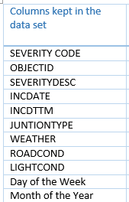
Features engineering
The sourced data set contained 38 features (columns) that were both relevant and irrelevant to the scope of the project namely, to predict the severity of accidents within the Seattle City border.
The features that relevant to the scope of the project are listed in the table 1. Day of Week and Month of the Year were derived from INCDATE and INCDTTM.

Slide 8
Data cleaning
Created a new data frame with the selected features
Identified the columns with missing values:
JUNCTIONTYPE (6329) - 3.25% of dataset
WEATHER (5081) - 2.6% of dataset
ROADCOND (5012) - 2.6% of dataset
LIGHTCOND (5170) - 2.7% of dataset
Due to the overlap of missing values between WEATHER, ROADCOND and LIGHTCOND, all rows in these columns with empty fields were deleted
Replaced empty fields in the JUNCTIONTYPE column with ‘Unknown’
For Machine Learning, all data types were converted to ‘int64’ and normalised

Slide 9
Exploratory data analysis
Assessed the relationship between various features (X) and the severity class (Y labels)
Analysed the data based on type of weather (or other feature / X) as a percentage of the class (Y)
I.e. when the weather is clear, what percentage of accidents only result in damage to property (class 1) and what percentage of accidents result in injury (class 2)

Slide 10
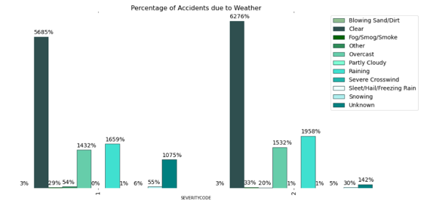
Exploratory data analysis – Severity and weather condition
In both severity classes the percentage frequency follows the same pattern
Except where the weather condition ‘Unknown’ is significantly higher in severity class 1 (damage to property). It is a factor that may have an impact on the usability of the model.
The following weather conditions are slightly higher in severity class 2 (injury):
Clear – 5.9% difference
Overcast – 1% difference
Raining – 2.99% difference

Slide 11
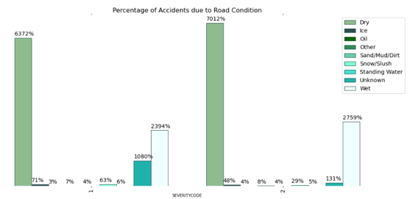
Exploratory data analysis – Severity and road condition
In both severity classes the percentage frequency follows the same pattern
Except where the weather condition ‘Unknown’ is significantly higher in severity class 1 (damage to property). It is a factor that may have an impact on the usability of the model.
The following road conditions are slightly higher in severity class 2 (injury):
Dry – 6.4% difference
Wet – 3.65 difference
This is in line with the results from
weather / severity analysis

Slide 12
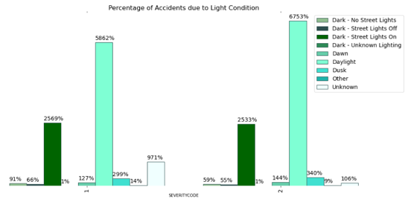
Exploratory data analysis – Severity and light condition
In both severity classes the percentage frequency follows the same pattern
Except where the weather condition ‘Unknown’ is significantly higher in severity class 1 (damage to property). It is a factor that may have an impact on the usability of the model.
The following road conditions are slightly higher in severity class 2 (injury):
Daylight – 8.91% difference

Slide 13
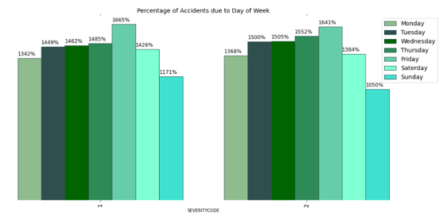
Exploratory data analysis – Severity and day of the week
In both severity classes the percentage frequency follows the same pattern, i.e. most accidents occur on a Friday.
There is no statistically significant difference between the severity of the accident and day of week.
Regardless of this observation, the practitioner
has decided to use this feature in the
Machine Learning models as the
Machine Learning algorithms may
be sensitive to small differences in
data

Slide 14
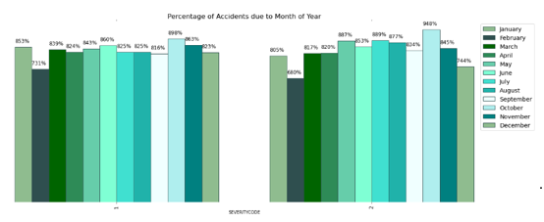
Exploratory data analysis – Severity and month of the year
In both severity classes the percentage frequency follows the same pattern
There is no statistically significant difference between the severity of the accident and month of the year
Regardless of this observation, the practitioner
has decided to use this feature in the
Machine Learning models as the
Machine Learning algorithms may
be sensitive to small differences in
data

Slide 15
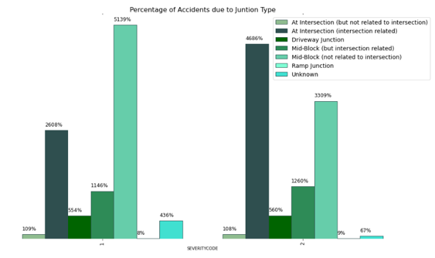
Exploratory data analysis – Severity and junction type
The percentage frequency between the two severity classes do not follow the same pattern
As with weather condition and road condition, the unknown factor contributes significantly
The following types of junction result in a higher probability for class 1 (property damage only):
Midblock – 18.3%
The following types of junction result in
a higher probability for class 2 (injury):
At intersection (intersection related) – 20.78%

Slide 16
Predictive modelling
Classification type of Machine Learning models were used
A shortcoming of the data is that it has unbalanced labels which will lead to biased Machine Learning models. Approaches to deal with unbalanced data are as follows:
Use different Machine Learning algorithms
Use accuracy validation techniques such as F1 – score, Jaccard index and Precision / Recall metrics.

Slide 17
Model development
The following Machine Learning classification algorithms were used:
K-Nearest Neighbours (KNN);
Decision Trees;
Support Vector Machines (SVM); and
Logistic Regression (LogLoss)
The following approach was used to develop the models:
Define features (X)
Convert the Pandas data frame to a numpy array
Define the labels (Y)
Normalise the data (this was not done for Decision Trees as it is not a requirement for the algorithm)
Split the data set into Train and Test sets (Train = 0.8 (151 469), Test = 0.2 (370868))
Train the model using the training data set
With the KNN algorithm the accuracy was calculated for different k values. Selected the k value (k = 8) with the highest accuracy
Use the model to predict, using the test data set

Slide 18
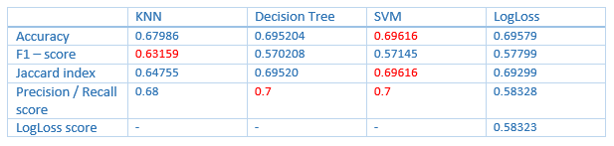
Model evaluation
The SVM model scored the highest in three of the four evaluation techniques

Slide 19
conclusion
Four different classification algorithms were used namely KNN, Decision Tree, SVM and LogLoss
The models were validated using different validation techniques namely Accuracy, F1 – score, Jaccard index and Precision / Recall score
The SVM model scored the highest in three of the four model validation techniques.

Slide 20
Future work
The inclusion of the other severity classes may enhance the usability of the model
The practitioner would also recommend the guideline that ‘Unknown’ should not be a selection option when capturing the data, or that fields should not be kept blank, as this further influences the usability of the model

